Slide 1
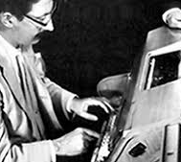

EEEEEE LL IIII ZZZZZZZ AAAAA EE LL II ZZ AA AA EEEEEE LL II ZZZ AA AAAAA EE LL II ZZ AA AA EEEEEE LLLLLL IIII ZZZZZZZ AA AA

Slide 2
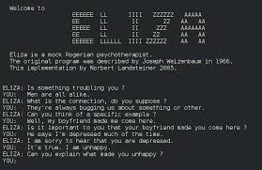
What is ELIZA?
One of the first chat bots
Joseph Weizenbaum
1964 - 1967

Slide 3
How did ELIZA work?
Seperate scripts
‘DOCTOR’

Slide 4
Weizenbaum’s concerns
Anthropomorphizing computers

